Slide 1

The GATK variant calling pipeline, changes since ASHG
Eric Banks, Ryan Poplin,
Guillermo del Angel, Mark DePristo
Genome Sequencing and Analysis Group
Medical and Population Genetics Program
Feb 1, 2011

Slide 2
Executive Summary:
We have made significant changes to all steps of our variant calling pipeline since ASHG in Nov 2010, including:
The genotype likelihoods calculation, using “fragment-based calling”.
The allele frequency calculation, using Heng Li’s exact calculation model.
The variant quality score recalibration step, removing all dependencies on Ti/Tv and using a contrastive clustering approach.
In order that our methods be completely transparent and to enable everyone in the Project to benefit from these improvements, we present the details here.

Slide 3
Step 1: further data processing
Official
1000G
BAMs
Indel Realignment
Re-compute BAQ tags
BAMs used
for calling
For the official 1000G BAMs, Indel Realignment is performed only at dbSNP and pilot indel sites. We additionally run the realignment at all sites for which the mapper (BWA/BFAST) has placed an indel in the original alignment. Note that this process is relatively fast as we no longer perform Smith-Waterman (but must be run on aggregated BAMs, not at the lane level).
We then re-compute the BAQ tags (this step is not strictly necessary).

Slide 4
Step 2a: variant discovery (SNPs)
Genotype Likelihoods
Calculation
Allele Frequency
Calculation
Variant Quality Recalibration
BAMs used
for calling
Beagle
Unified Genotyper
We note that we no longer use any hard-filters (proximity to indel calls, clustered SNPs) at any point in the process.

Slide 5
Step 2a: variant discovery (SNPs)
Genotype Likelihoods
Calculation
Allele Frequency
Calculation
Variant Quality Recalibration
BAMs used
for calling
Beagle
Unified Genotyper
The genotype likelihoods calculation now takes overlapping read pairs (where bases are not independent observations) into account, which we term “fragment-based calling”.

Slide 6
Motivation for fragment-based calling:
Our previous genotype likelihoods model assumed independence between all reads, including paired end reads from the same fragment.
But this assumption breaks down for short fragments where read pairs overlap.
We need to be able to distinguish between e.g. PCR errors and actual polymorphisms (esp. in low-pass).
A
A

Slide 7
New Genotype Likelihoods Math:
Read-based math:
where
Fragment-based math:
where

Slide 8
Fragment-based likelihoods, example:
p = PCR error rate (10⁻⁴)
e = sequencing error rate (from base quals)

Slide 9
How does fragment-based calling affect raw low-pass calls?
Data: raw calls on 1MB of chr20 on the 79 Phase I FIN samples
Fragment-based
Read-based
5,278
1
52
Good confidence in this site (see later slide)
No confidence in any of these sites based on inspection in IGV
1% of raw calls – all singletons – disappear with fragment based calling!

Slide 10
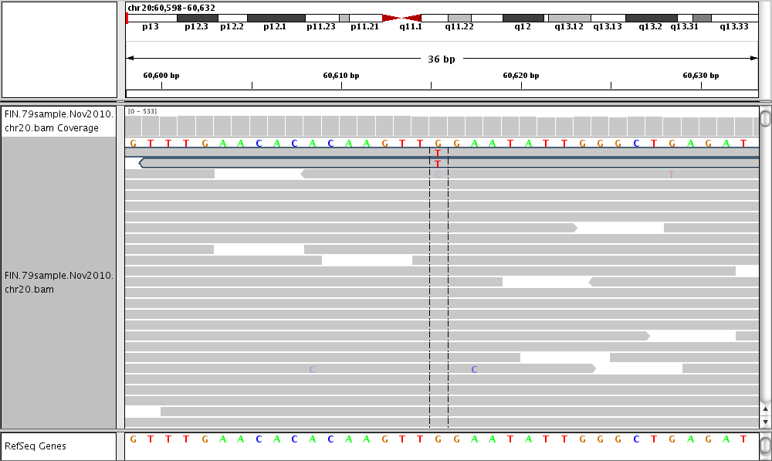
A possible PCR error no longer gets called with fragment-based calling
5 independent REF bases
for this sample
The 2 ALT bases are from
the same read pair; not
observed in any other sample

Slide 11
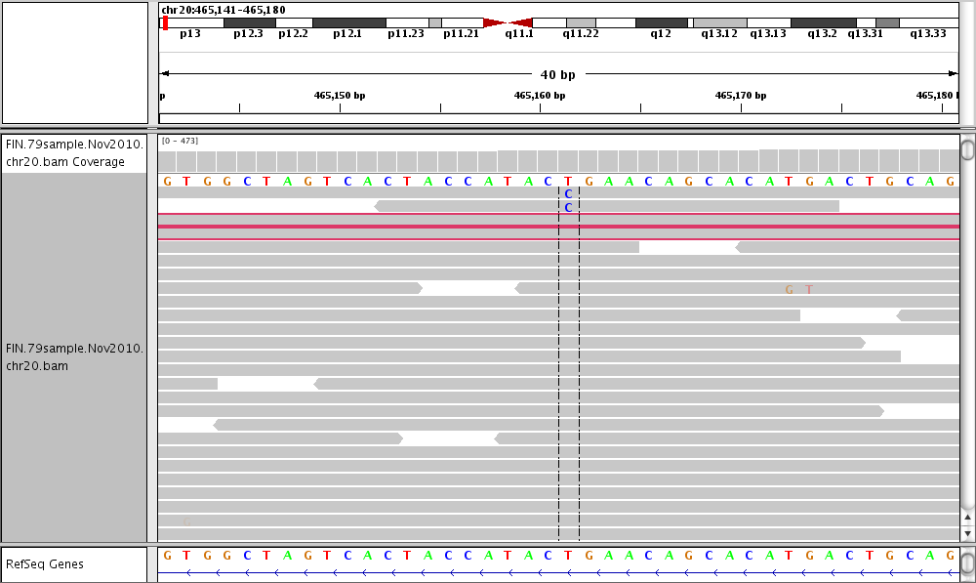
A probable singleton now gets called with fragment-based calling (less reference bias)

Slide 12
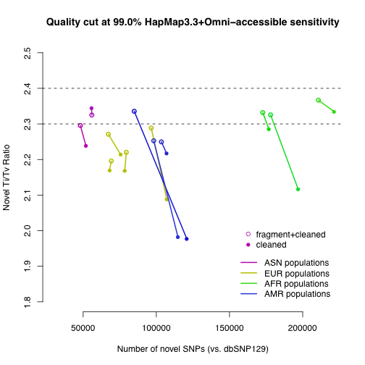
Fragment-based calling improves Phase I callsets
LWK
TSI
YRI
CHS
PUR
CEU
ASW, marginal ti/tv = 0.95
MXL, marginal ti/tv = 1.37
More improvement seen with newer data because the longer reads result in a higher chance of having overlapping read pairs.

Slide 13
Step 2a: variant discovery (SNPs)
Genotype Likelihoods
Calculation
Allele Frequency
Calculation
Variant Quality Recalibration
BAMs used
for calling
Beagle
Unified Genotyper
We now use Heng Li’s Exact model to calculate P(AF>0) instead of our previous heuristic grid search model.

Slide 14
Step 2a: variant discovery (SNPs)
Genotype Likelihoods
Calculation
Allele Frequency
Calculation
Variant Quality Recalibration
BAMs used
for calling
Beagle
Unified Genotyper
The variant quality recalibration process has gone through a major overhaul recently. Most notably, we have removed any dependency on Ti/Tv in the calculation. This and further changes are highlighted in the following slides.
Outline:
Quick Variant Recalibration overview
Contrastive clustering walkthrough
Ti/Tv-free cutting
Improvements to Haplotype Score and Strand Bias annotations

Slide 15
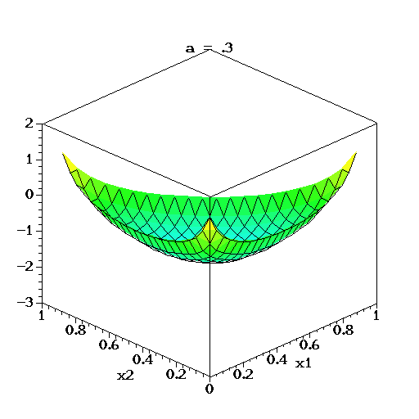
Reminder: Variant Recalibration
Gaussian Mixture Model trained on annotated variants, find MAP using VBEM:
Dirichlet distribution
Normal – inverse Wishart distribution
Prior expectation is the empirical mean and empirical covariance of the data.
Bias away from singularities.
Prior expectation is sparse set

Slide 16
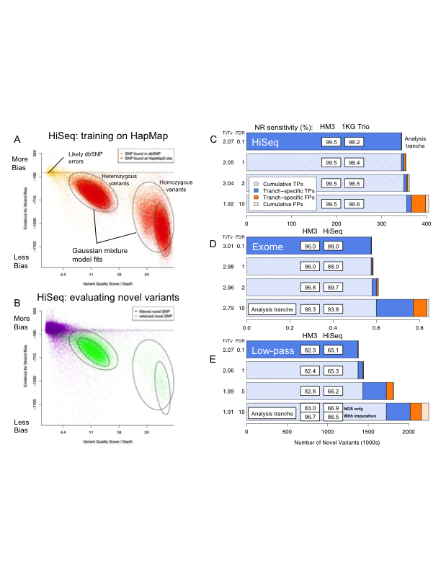
Variant Quality Score Recalibration: training on highly confident known sites to determine the probability that other sites are true

Slide 17
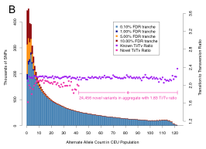
The low confidence tranches are comprised of the low frequency events (most likely FPs)
61-sample CEU from 1KG

Slide 18
Step 2a: variant discovery (SNPs)
Genotype Likelihoods
Calculation
Allele Frequency
Calculation
Variant Quality Recalibration
BAMs used
for calling
Beagle
Unified Genotyper
The variant quality recalibration process has gone through a major overhaul recently. Most notably, we have removed any dependency on Ti/Tv in the calculation. This and further changes are highlighted in the following slides.
Outline:
Quick Variant Recalibration overview
Contrastive clustering walkthrough
Ti/Tv-free cutting
Improvements to Haplotype Score and Strand Bias annotations

Slide 19
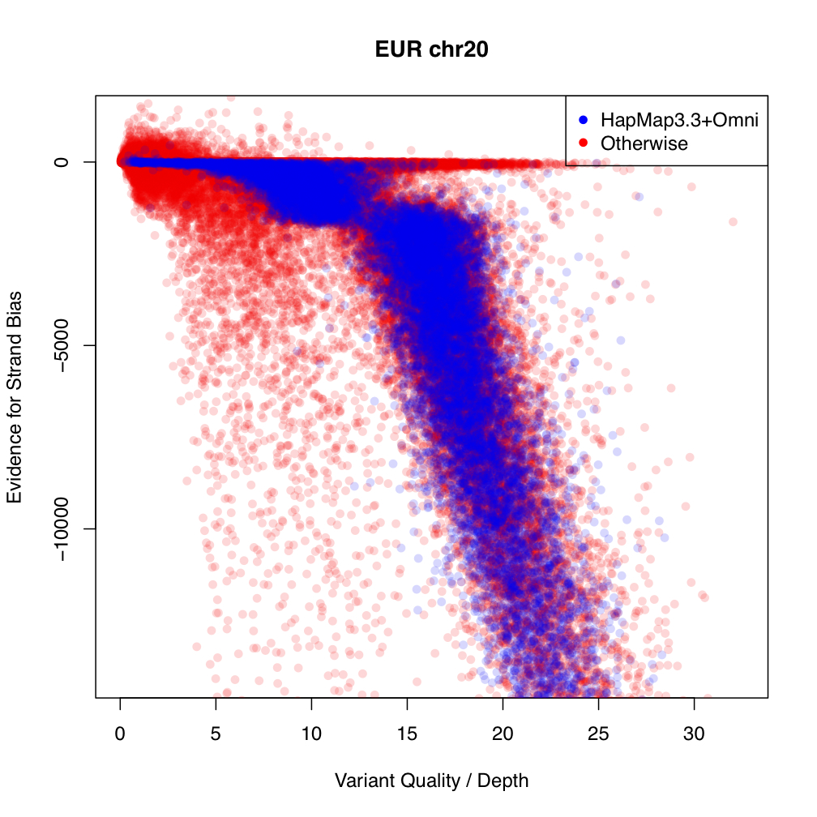
Contrastive VQSR Clustering Walkthrough
First partition the data into a training set by looking at sites which overlap with HapMap3.3 and the Omni chip.

Slide 20
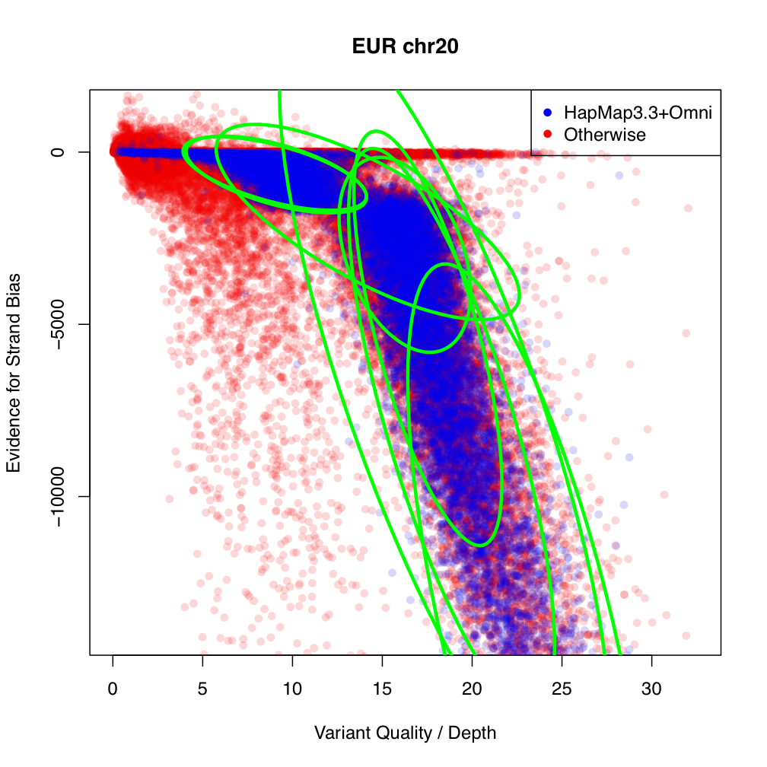
Contrastive VQSR Clustering Walkthrough
Using Variational Bayes EM algorithm learn clusters over the training set

Slide 21
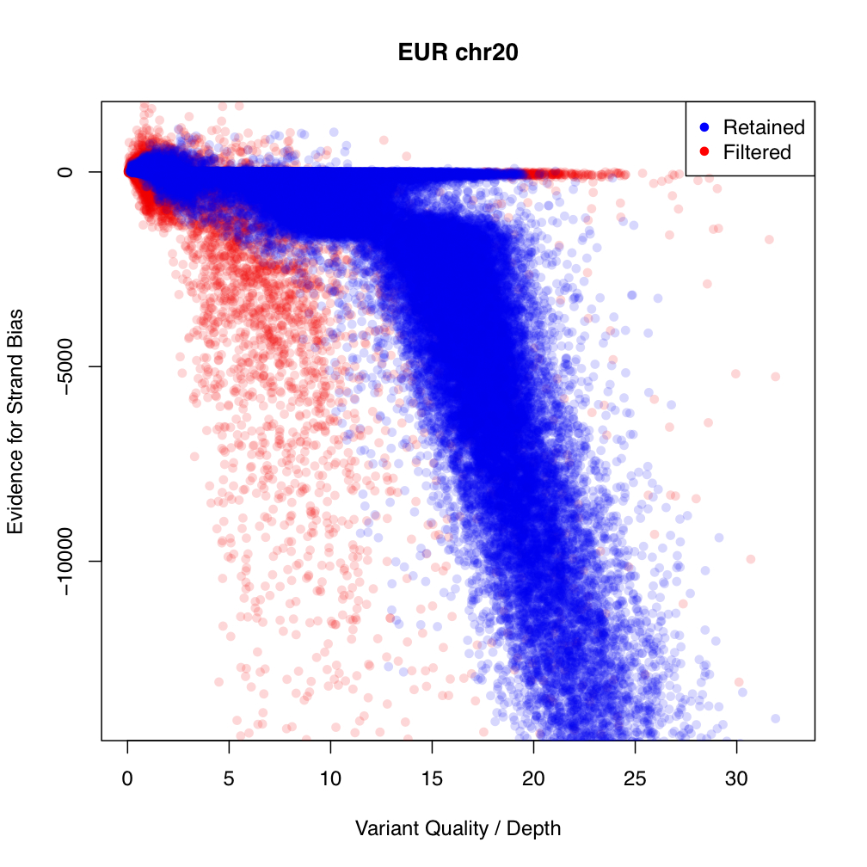
Contrastive VQSR Clustering Walkthrough
Assign a probability to each variant based on how well it clusters with the training set.
Unfortunately a sizeable number of seemingly good variants fall outside of the main clusters.
Furthermore, all clusters are essentially two-sided tests but most annotations are really only one-sided.

Slide 22
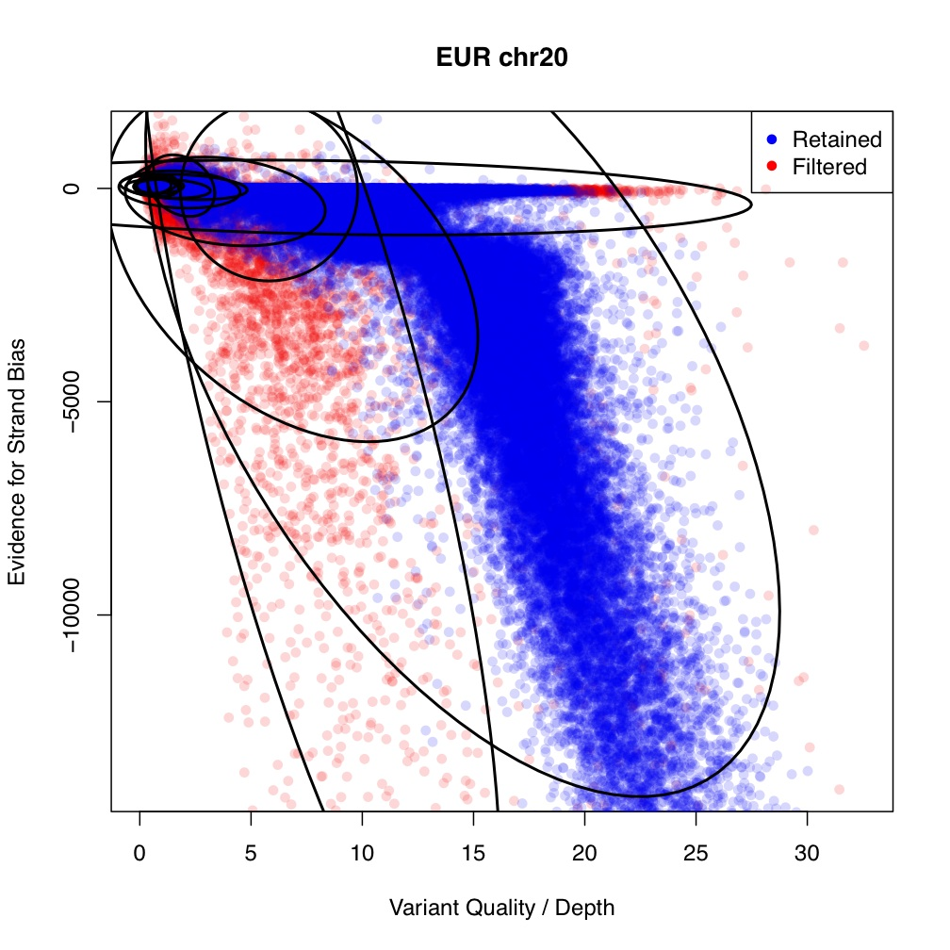
Contrastive VQSR Clustering Walkthrough
Solution: Train a second set of clusters based on the bottom 10% of variants which had the lowest LOD.
This model for the bad variants allows for contrastive evaluation. New LOD score becomes difference between the good model and the bad model.

Slide 23
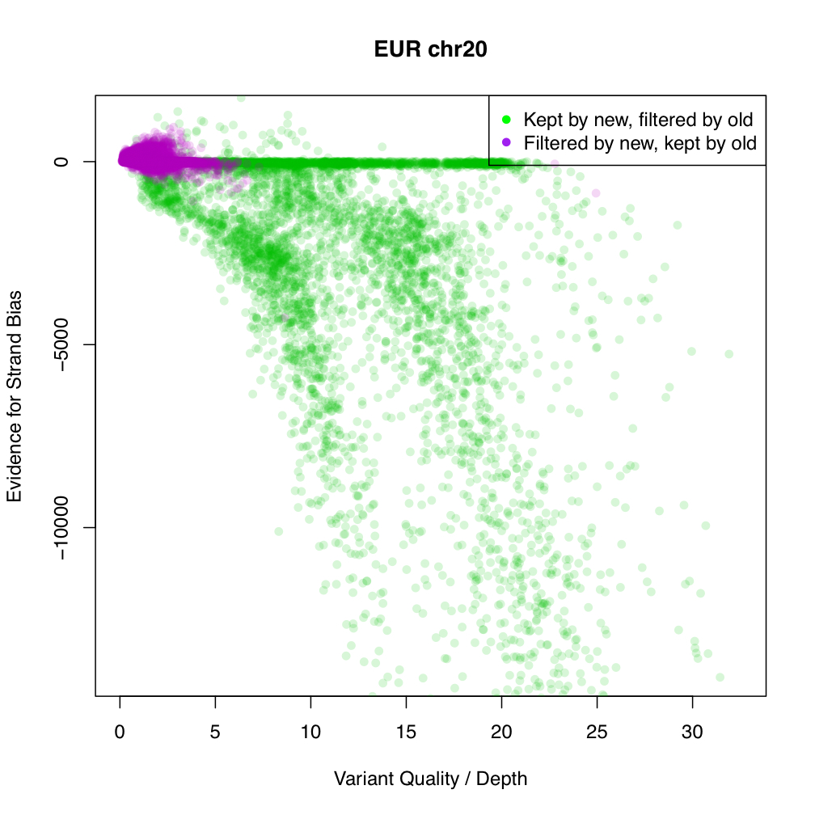
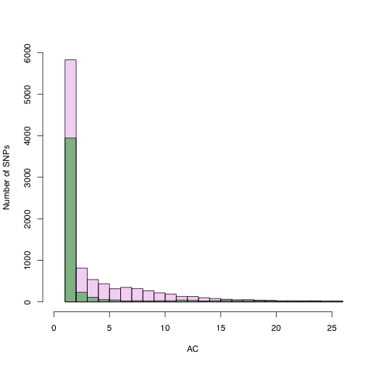
Contrastive VQSR Clustering Walkthrough
Contrastive VQSR clustering allows us to rescue the variants which fall outside of the main clusters but which also don’t fit the model for bad variants.

Slide 24
Step 2a: variant discovery (SNPs)
Genotype Likelihoods
Calculation
Allele Frequency
Calculation
Variant Quality Recalibration
BAMs used
for calling
Beagle
Unified Genotyper
The variant quality recalibration process has gone through a major overhaul recently. Most notably, we have removed any dependency on Ti/Tv in the calculation. This and further changes are highlighted in the following slides.
Outline:
Quick Variant Recalibration overview
Contrastive clustering walkthrough
Ti/Tv-free cutting
Improvements to Haplotype Score and Strand Bias annotations

Slide 25
Removing Ti/Tv from variant quality score recalibration
Previous approach: run calls through variant recalibration, order SNPs by their LOD, and then cut SNP calls where novel Ti/Tv ratio falls below some target
New approach: run calls through variant recalibration, order SNPs by their LOD, and then cut the SNPs at given sensitivities to a truth set
In subsequent examples we use HapMap3 sites as the truth set, cutting the calls when they include 99% of accessible HM3 sites
For 1000G calling, we instead use polymorphic Omni2.5 sites as the truth set
Note that this new approach doesn’t require being able to find all true sites (the cut is made at 99% of sites from the truth set that are available in the raw call set), nor does it require knowledge of the true Ti/Tv ratio.

Slide 26
Results of both approaches on various data sets are similar
Data |  | N. known | N. novel | Known TiTv | Novel TiTv | Truth sensitivity
NA12878 HiSeq WGS | TiTv target | 3239769 | 360906 | 2.15 | 2.05* | 99.3
 | HM3 truth | 3207449 | 341750 | 2.15 | 2.09 | 99.0*
NA12878 GAII WEx | TiTv target | 16233 | 1043 | 3.26 | 2.58* | 99.4
 | HM3 truth | 16050 | 986 | 3.28 | 2.63 | 99.0*
1000G Broad low-pass calls from August | TiTv target | 185141 | 444473 | 2.40 | 2.28* | 98.9
 | HM3 truth | 185518 | 449008 | 2.40 | 2.28 | 99.0*
Targeted values

Slide 27
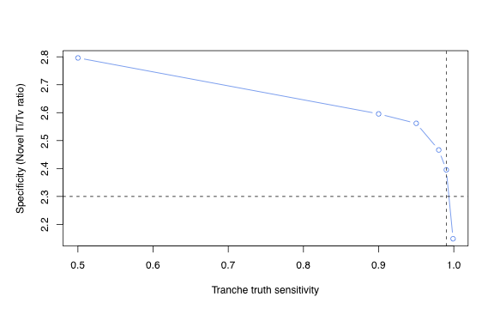
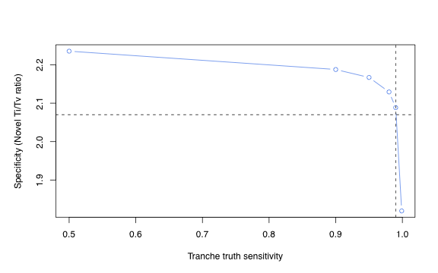
Sensitivity vs. specificity plots with the new Ti/Tv-less approach look good
1000G low-pass August N=629
NA12878 HiSeq WGS

Slide 28
Step 2a: variant discovery (SNPs)
Genotype Likelihoods
Calculation
Allele Frequency
Calculation
Variant Quality Recalibration
BAMs used
for calling
Beagle
Unified Genotyper
The variant quality recalibration process has gone through a major overhaul recently. Most notably, we have removed any dependency on Ti/Tv in the calculation. This and further changes are highlighted in the following slides.
Outline:
Quick Variant Recalibration overview
Contrastive clustering walkthrough
Ti/Tv-free cutting
Improvements to Haplotype Score and Strand Bias annotations

Slide 29


Reminder: haplotype scoring algorithm
1. Split reads into reference / alternate pileups and determine the best consensus haplotype sequence for each set of reads
Ref:
AAGCGTCG
AAGCGTCG
Consensus based on reference base
Three adjacent SNPs
Haplotype consensus
AAGCTACG
Consensus based on alternative alleles
2. Go back through all of the reads and score their probability of being sampled from each of the two most likely haplotypes:
P(read | haplotype_{j}) = sum_b_{i} ( b_{i} == h_{i} ? e_{i} : 1 – e_{i} / 3 ) – sum_b_{i} e_{i}
3. Total haplotype score is the sum_reads sum_haplotypes P(read | haplotype)

Slide 30
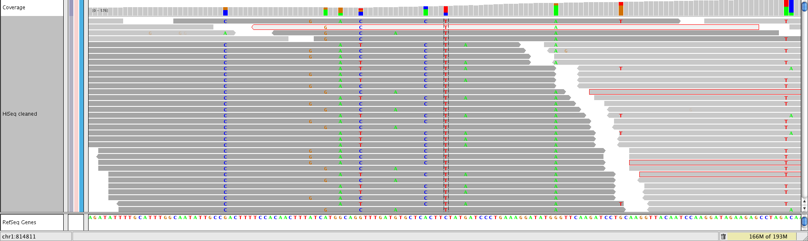
An example of a site from HiSeq WGS with a BAD haplotype score (i.e. small likelihood of the site being explained by at most 2 haplotypes)

Slide 31
Recent improvements made to the Haplotype Score
When building haplotype blocks to choose a consensus we now parse the read’s Cigar string to:
Skip over soft-clipped bases
Use insertion and deletion bases as possible haplotype markers
Only use reads from the filtered context to build haplotypes
Score each sample separately and then average the scores
Enlarged window from +/- 10 bases to +/- 20 bases
‘N’ bases are treated as wildcards in haplotypes
When choosing consensus haplotypes we use a priority queue to decide which haplotypes to merge together
Base quality scores < 4.0 don’t have any mathematical meaning

Slide 32
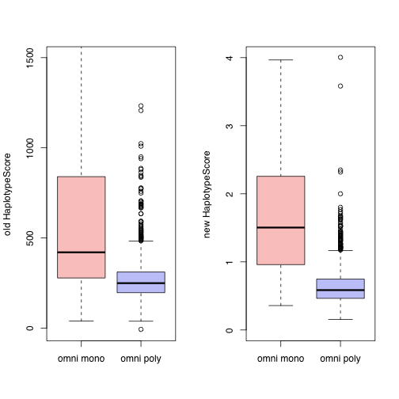
1000G August chr20, 629 samples
Increased separation between Omni monomorphic and polymorphic sites!

Slide 33
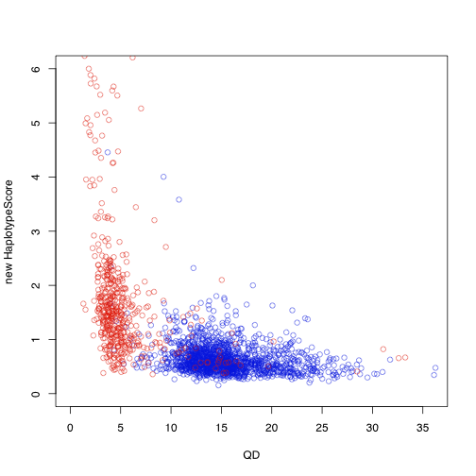
1000G November chr20, 79 FIN samples
Good separation between Omni monomorphic and polymorphic sites!

Slide 34
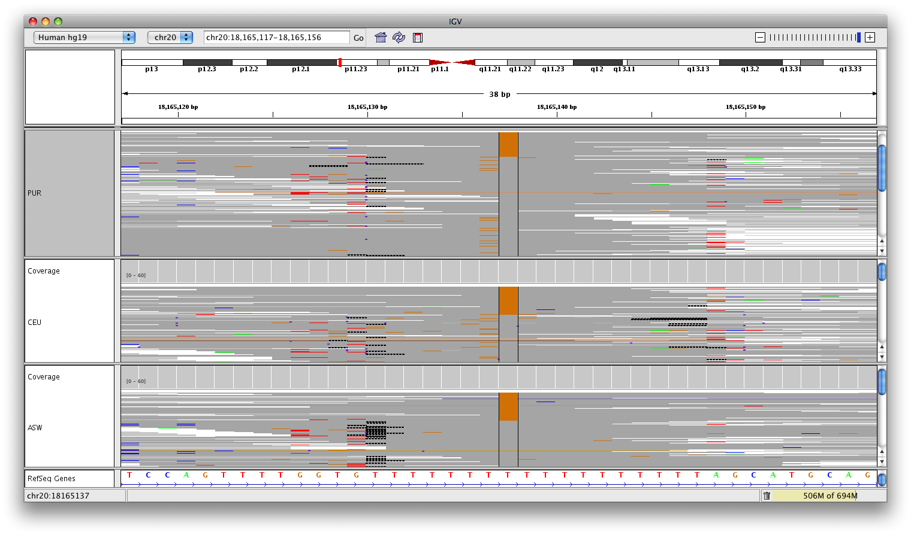
This dbSNP 129 site looks to be correctly filtered by the new Haplotype Score in 1000G Nov 2010 data

Slide 35
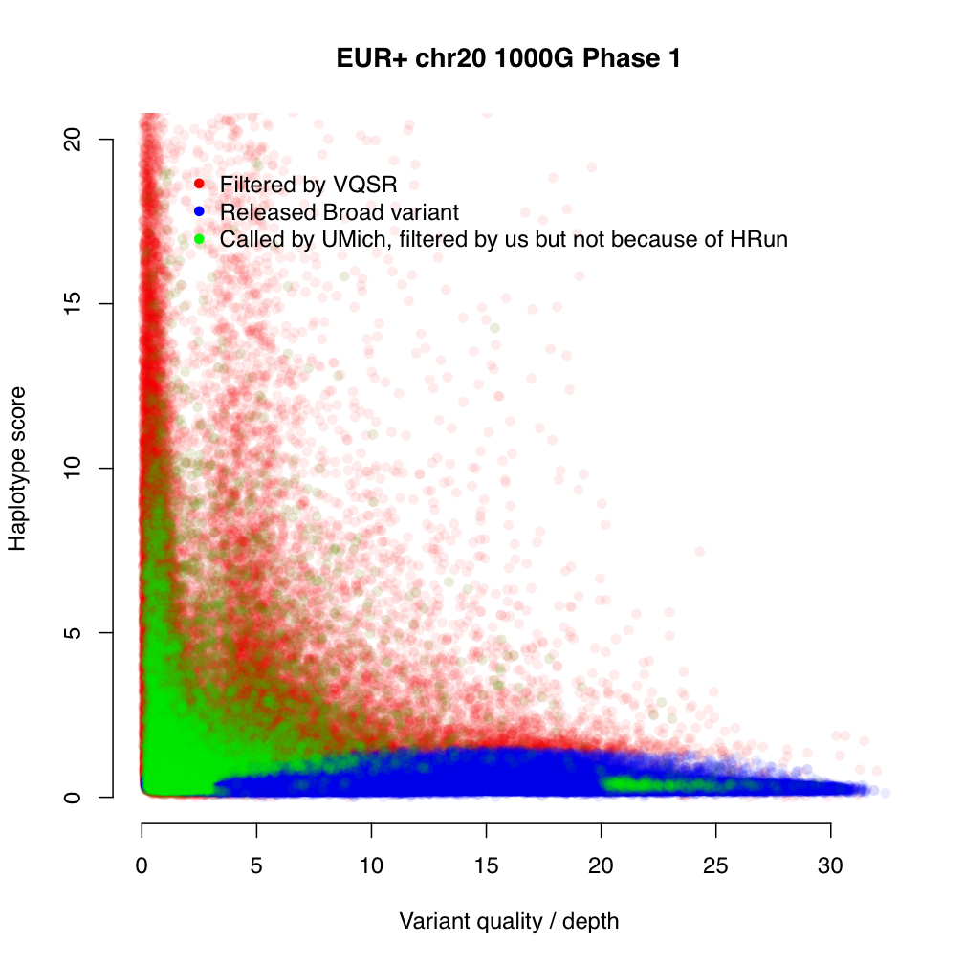
Variants with bad Haplotype Scores often exhibit good Ti/Tv ratios and are included in other centers’ callsets, but are likely false positives

Slide 36
Strand bias (SB) algorithm
Old strand bias calculation:
New strand bias calculation:

Slide 37
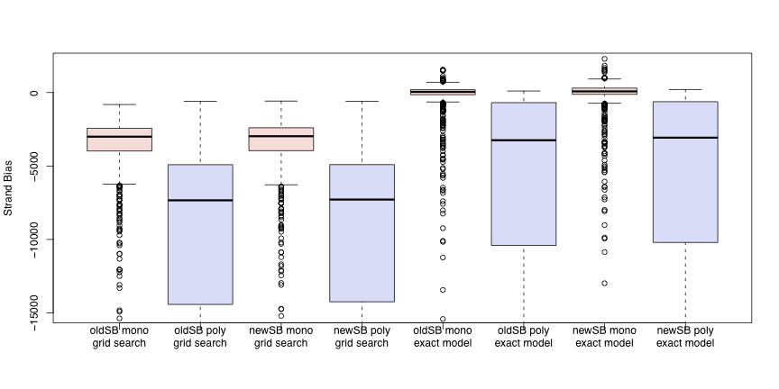
1000G August chr20, 629 samples
Greatly increased separation between monomorphic and polymorphic sites
grid search
exact model
Major improvement comes from more accurate estimation of P(AF=0) or P(AF>0) with the Exact AF calculation, NOT the switch from P(AF=i) to P(AF>0) in the SB calculation

Slide 38
Step 2b: variant discovery (indels)
Genotype Likelihoods
Calculation
Allele Frequency
Calculation
BAMs used
for calling
Hard-filters
Beagle
Unified Genotyper
The genotype likelihoods calculation is inspired by and based on Dindel (with kind permission from C Albers and R Durbin; it is invoked as the “DINDEL” model inside the Unified Genotyper). The implementation occasionally does, however, depart from that of Dindel; most notably:
Indel discovery in the GATK in based on a heuristic model requiring a minimal number of consistent indel alleles present in the reads
The formulation of the Profile HMM for the probabilistic realignment has been simplified slightly

Slide 39
Step 2b: variant discovery (indels)
Genotype Likelihoods
Calculation
Allele Frequency
Calculation
BAMs used
for calling
Hard-filters
Beagle
Unified Genotyper
We are actively working on incorporating the indel covariates into the Variant Quality Recalibration process and expect that to drastically improve our final callset. In the meantime, we continue to use parameterized hard-filters based on strand bias, homopolymer run, and variant quality / depth.

Slide 40
Step 2b: variant discovery (indels)
Genotype Likelihoods
Calculation
Allele Frequency
Calculation
BAMs used
for calling
Hard-filters
Beagle
Unified Genotyper
We are additionally working on incorporating indels into the Base Quality Score Recalibration framework (essentially assigning a phred-scaled quality score to each indel present in the alignments) and expect that to have a significant effect on the accuracy of the calling. We look forward to sharing these results when ready.

Slide 41
Conclusions:
We have made significant changes to all steps of our variant calling pipeline recently, most notably:
The genotype likelihoods calculation, using “fragment-based calling”.
The allele frequency calculation, using Heng Li’s exact calculation model.
The variant quality score recalibration step, removing all dependencies on Ti/Tv and using a contrastive clustering approach.
Indel calling capabilities

